Slide 1
IMAGE PROCESSING
WEEK-1

Slide 2
2. Concept of images and pixels

Slide 3
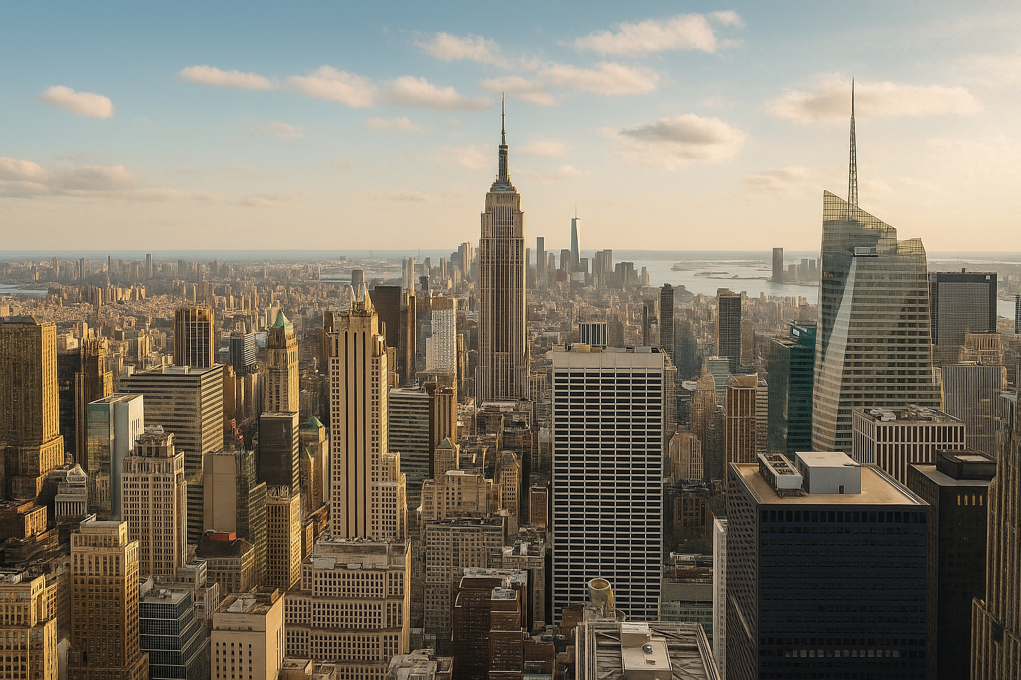
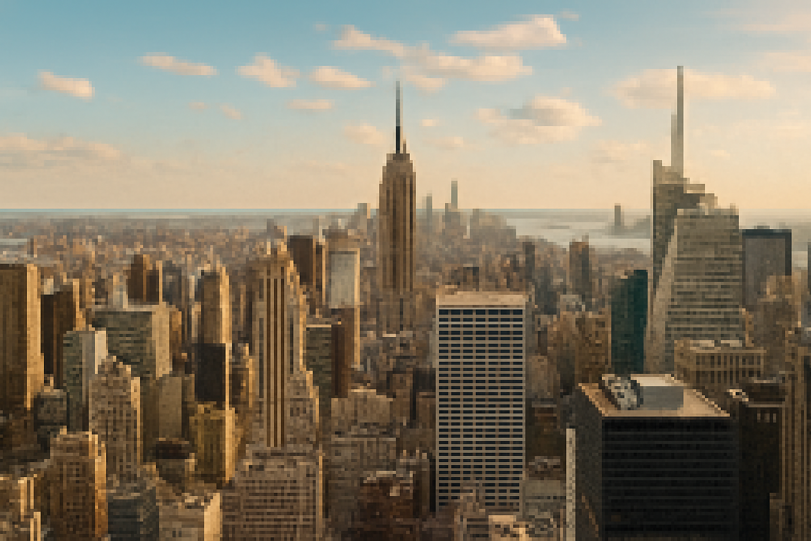
Image resolution -
Resolution refers to the number of pixels in an image and determines its clarity and detail.
High resolution means more pixels and sharper images.
Low resolution means less pixels and blurry image.
The resolution of a digital image is measured in “Pixel per inch”
215 ppi
23 ppi

Slide 4
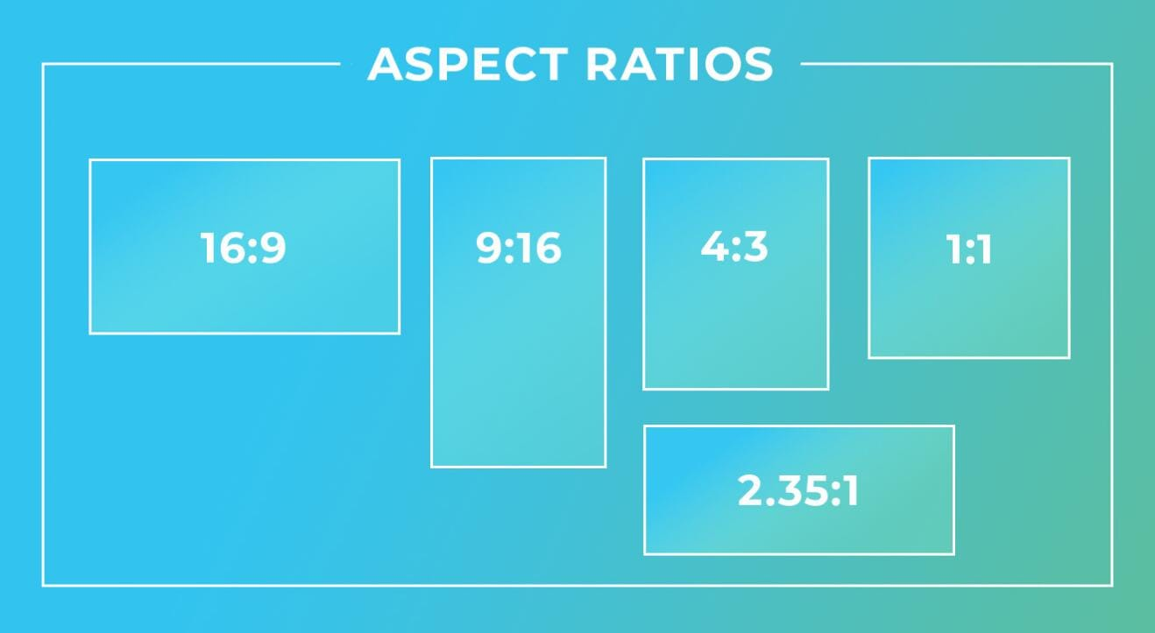
Image Aspect Ratio-
The proportional relationship of image’s width and height.
It is written as W:H,for example:- 16:9 where width is 16 units and height is 9 units
Aspect ratio does not tell you the actual size but only represents the shape of the image.
Aspect ratio is important:
Display consistency- images looks correct on different screens
Preventing distortion- as wrong aspect ratio causes: stretching , squishing , cropping
Used for web, UI/UX, social media templates.

Slide 5
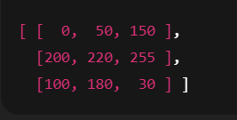
Pixel matrix representation:
Pixel : A pixel is the smallest unit of digital image or display and stands for “picture element”. It is a very small , isolated dot thats stands for one color. Each pixel stores the color or intensity information.
A digital image is represented as matrix(2D array) of tiny dot called pixels
Pixel matrix for different types images:
Grayscale image(2D matrix):
- 0 -> black
- 255 -> white
- Between 0-255-> shades of gray
Color image(3D matrix):
- the color image is represented as as 3D matrix - Height X width X channels
- PIxels -> [255,0,0] -> full red
- Pixels -> [0,255,0] -> full green
- Pixels -> [0,0,255] -> full blue

Slide 6
Channels(RGB):
Color images store colors by using three separate metrics called channels:
R-Red channel
G-green channel
B-blue channel
Each channel is a gray scale matrix
For example:
Red channel highlights red parts of the image
Green channel highlights the green objects
Blue channels highlights the blue objects.

Slide 7
Histograms:
A histogram is a graph that shows the distribution of pixels intensity values in an image.
Types of histograms:
Histogram for grayscale images:
A grayscale images have pixel value from 0 to 255.
A histogram counts how many pixels fall into each of these 256 values.
Histogram for color images:
Color images have 3 channels -> R , G , B
Each channel has its own histogram:
Red channel histogram
Green channel histogram
Blue channel histogram
Characteristics :
Brightness- defines brightness , right->bright image , left-> dull image.
Contrast- narrow histogram-> low contrast image , wide-> high contrast
Under -exposed or over-exposed- too many pixels on left-> underexposed , too many in the right-> overexposed.

Slide 8

Image intensity:
Image intensity refers to the brightness value of the pixels in an image.
Intensity describe how light and dark a pixel is
In grayscale images, intensity is determined by a single value(0-255)
In color image it is derived from the color channels(R , G , B)
Intensity in grayscale images:
A grayscale pixel has a single value that ranges between 0-255
0 -> dark pixel , 255 -> bright pixel
Intensity in color images:
Color pixel has three values(R,G,B)
Intensity in color image = combined brightness
The formulae to calculate the intensity ->
Importance of image intensity:
Thresholding : separating foreground from background
Edge detection : edges-> change of intensity
Feature extraction : textures,corners and gradients depends on intensity variations.
Intensity range:
Most images uses 8-bit per pixel(0-255) but 16bit (0-65,535) is also used(medical)

Slide 9
Noise & gradients:
Noise are the unwanted random variation in pixel values.
It makes an image look grainy, speckled or distorted.
Types of noise:
Gaussian noise : caused by temperature, low light , it looks like soft grain
Salt-and-Pepper noise : appear as random black(0) and white(255) spots, caused by transmission errors, looks like scattered dots
Poisson noise(shots noise) : caused by photon fluctuations(low light), common in astronomy , medical imaging
Speckle noise : it is a type of multiplicative noise , occurs in ultrasound , radar images
Removal techniques:
Gaussian noise : gaussian blur
Salt and pepper : median filter
Speckle noise : adaptive or smoothing filters

Slide 10
Gradients:
Gradients measure how intensity changes between pixels.
Gradient refers to -> rate of change
Gradients helps in:
Edge detection
corner/feature detection
Image sharpening
Object recognition
Segmentation
Gradient filters:
- sobel operator - detects horizontal and vertical edges
- Prewitt operator - deals with simpler weights.
- scharr operator - improved for accurate gradients
- laplacian operator - detects edges in all direction

Slide 11
Kernel operations:
A kernel is a matrix used for modify the pixels of an image
Ex: 3X3, 5X5 ,7X7
Kernel operations are the set set of operations that are used in image processing and computer vision
How kernel works:
A kernel slides over the image pixel-by-pixel.
At each position:
The overlapping pixels are multiplied with the kernel values.
The results are added
The sum is placed in the corresponding location in the resulting matrix.
Types of kernel operations :
Blurring/Smoothing : removes noises, smoothen the image,reduces details
Sharpening : highlighting edges, helps the image appear more crip/sharp
Edge detection : used for detecting vertical and horizontal edges.
Padding : is the addition of zeros to compensate the loss
Strides: how many pixels the kernel jumps each steps

Slide 12
codes:
Hands on -
https://colab.research.google.com/drive/1lx9h8H3uuINCDS-knwychZ9rHqbuzSGn#scrollTo=J-ZGL7-CTxm8
POC -
Show how changing a single pixel can impact:
Edges
Classification outcome
https://colab.research.google.com/drive/17ePsRw9o_TF3c-eNcLi7sB3n9Rb06sxt#scrollTo=ZxsA75pJVhRy

